Slide 1
Introduction to Cython
Date: 2022/11/18
Speaker: 化學四 沈智恩

Slide 2
Outline
Introduction
Implementation
My research
Summary

Slide 3
Introduction

Slide 4
Why Is Python So Slow?
Interpreted language
Just-in-time compilation
Global interpreter lock (GIL)

Slide 5
Why We Need Cython?
Cython: C-extension of python
Cython can accelerate your python code
Compare with C/C++, writing cython code is much easier
My comments: numpy and scipy library can still be used in cython!

Slide 6
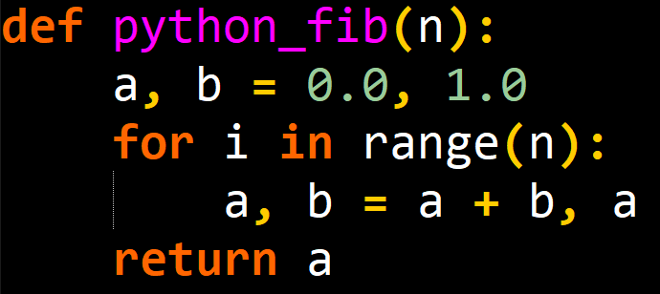
Fibonacci Sequence in Python
Simple python code

Slide 7
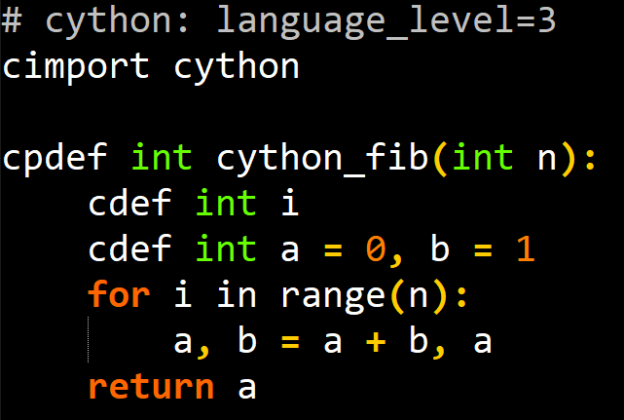
Fibonacci Sequence in Cython
cfib.pyx
setup.py
fib.py
Difference
Variables declaration
Function declaration (cdef, cpdef)
Language level: python 3 or python 2

Slide 8
Comparison of Python and Cython
n | Python running time (s) | Cython running time (s)
100 | 9.77e-06 | 2.31e-06
1000 | 7.67e-05 | 3.00e-06
10000 | 5.59e-04 | 7.89e-06
100000 | 5.35e-03 | 5.58e-05
1000000 | 5.56e-02 | 5.52e-04

Slide 9
Implementation

Slide 10
How to Run Cython?
In Windows, you need to install Visual Studio
Github: https://github.com/Ch-EnShen/cp_mid
Installation
Write cython code and save it as .pyx
Create setup.py
Build
pip install Cython
Prepare 3 files:
cython.pyx
setup.py
main.py
python setup.py build_ext --inplace

Slide 11
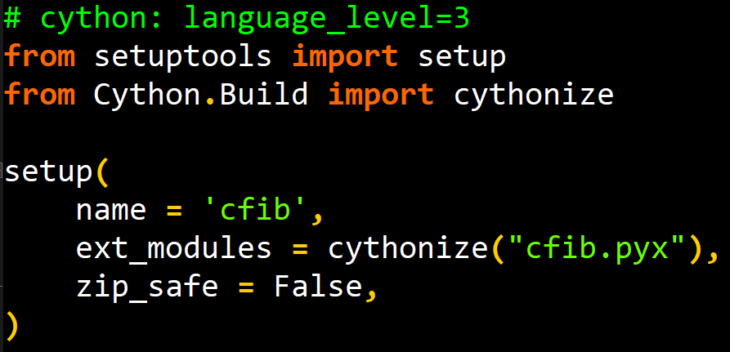
Setup.py
cfib.pyx
setup.py
fib.py
Define languege_level, and import cython module is needed

Slide 12
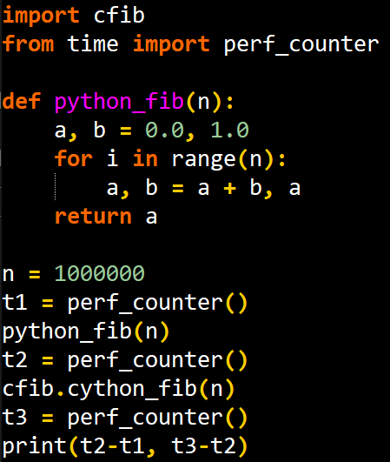
Fib.py
cfib.pyx
setup.py
fib.py

Slide 13
Comparison of Python, Cython, and C
 | Python | Cython | C
Speed

Slide 14
My Research

Slide 15
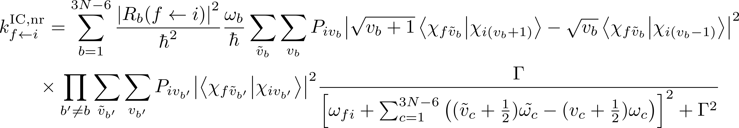
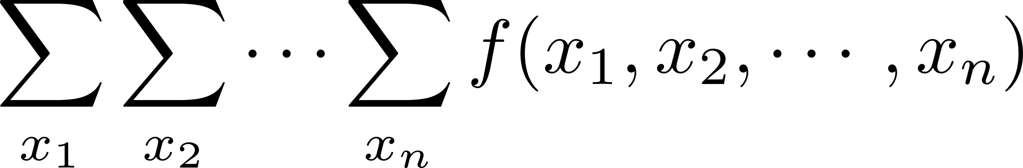
Internal conversion rate
Non-linear molecule with N atoms → 3N-6 vibrational modes → 7N-12 summation
From Fermi’s golden rule

Slide 16
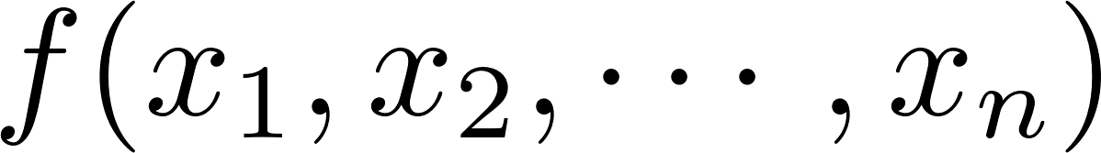
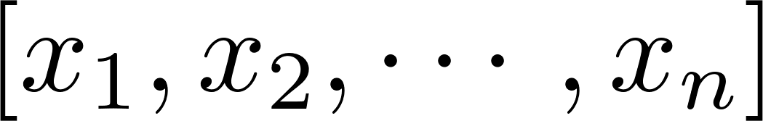
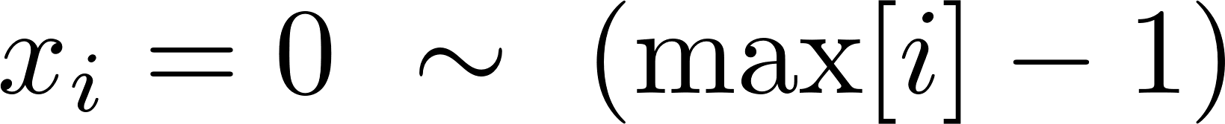
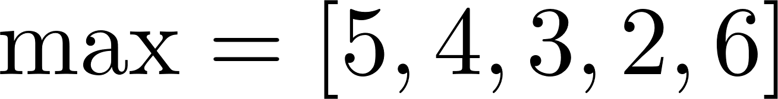

Code Implementation
To implement
Construct the function
Input is an array
Generate for each
E.g.
$5×4×3×2×6=720$combinations
0~4
0~3
0~2
0~1
0~5

Slide 17
Algorithm

Slide 18
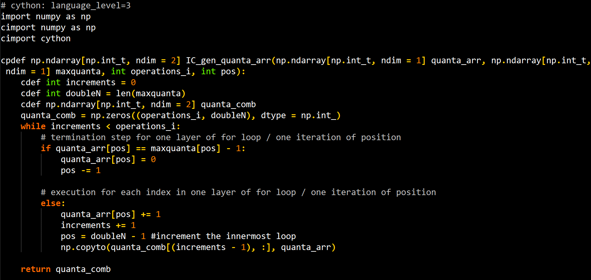
Cython Code

Slide 19
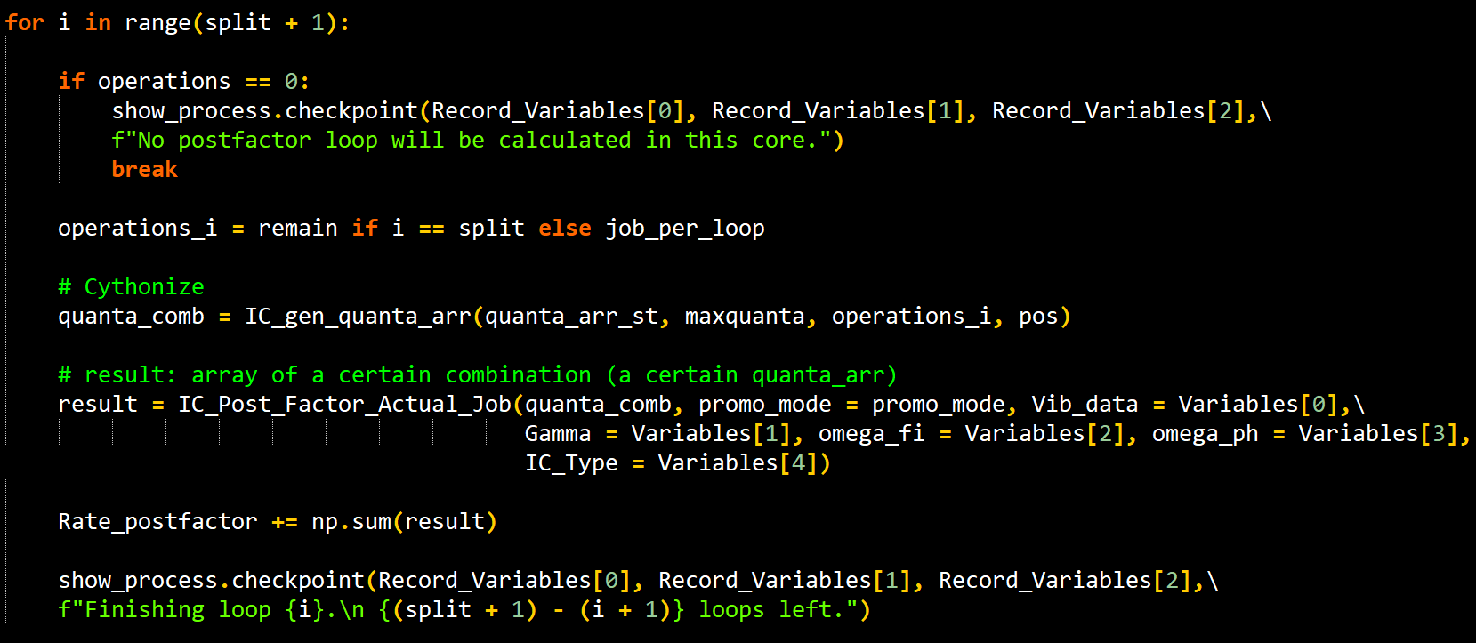
In Python…

Slide 20
Reference
Cython documentation: https://cython.readthedocs.io/en/latest/
https://www.51cto.com/article/711919.html
https://buzzorange.com/techorange/2018/08/14/python-is-slow/
https://jarvus.dragonbeef.net/note/noteCython.php

